Slide 1
Learning Dynamical Systems From Data
Axle Zhao
APMA 2070
Prof. George Karniadakis

Slide 2
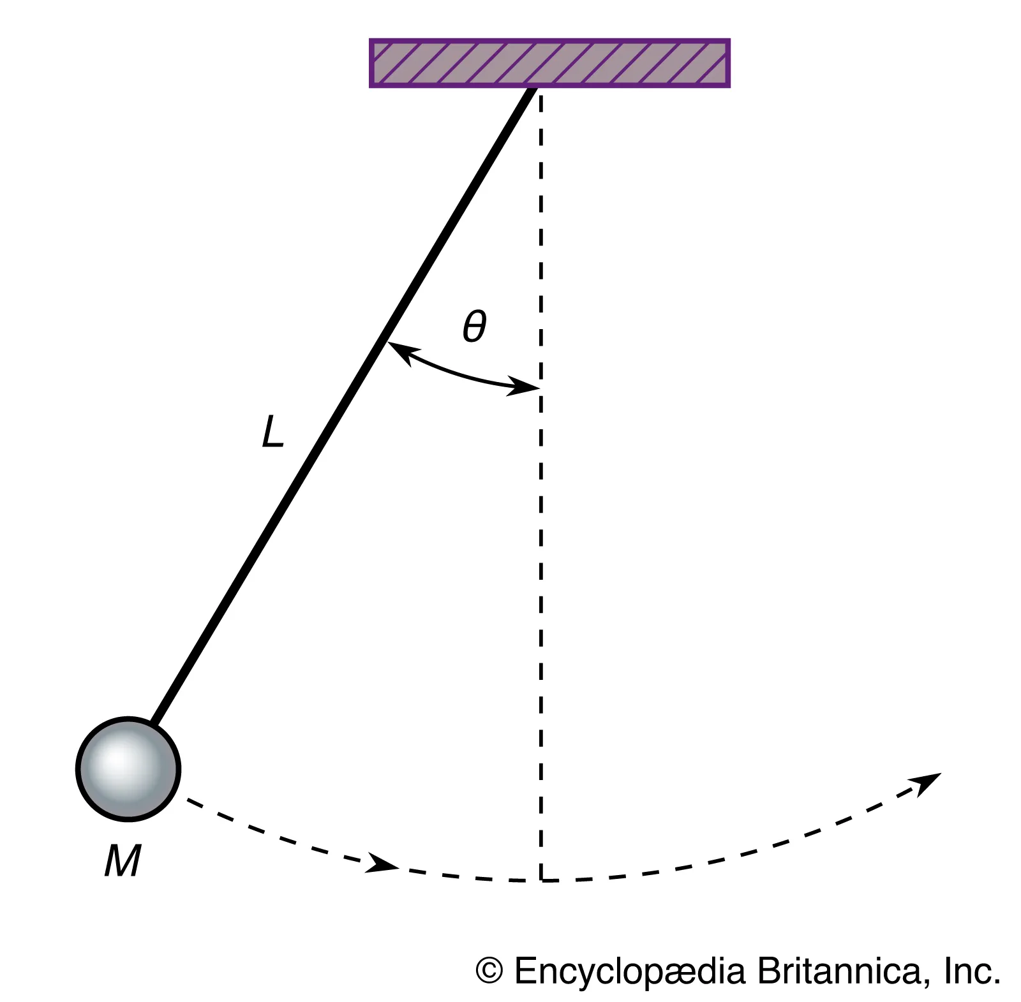
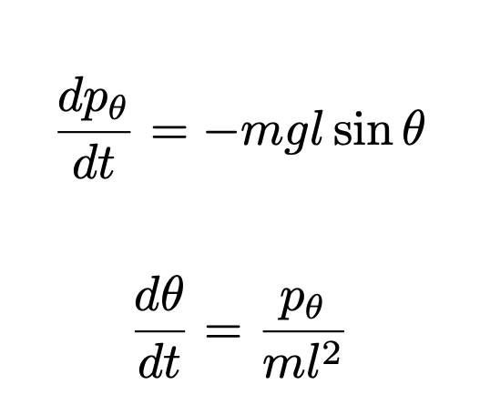
Background - Pendulum
Hamiltonian equations of motion:
g: gravitational constant
L: pendulum length
θ: angular displacement
pθ: angular momentum
[1]https://www.britannica.com/technology/pendulum

Slide 3
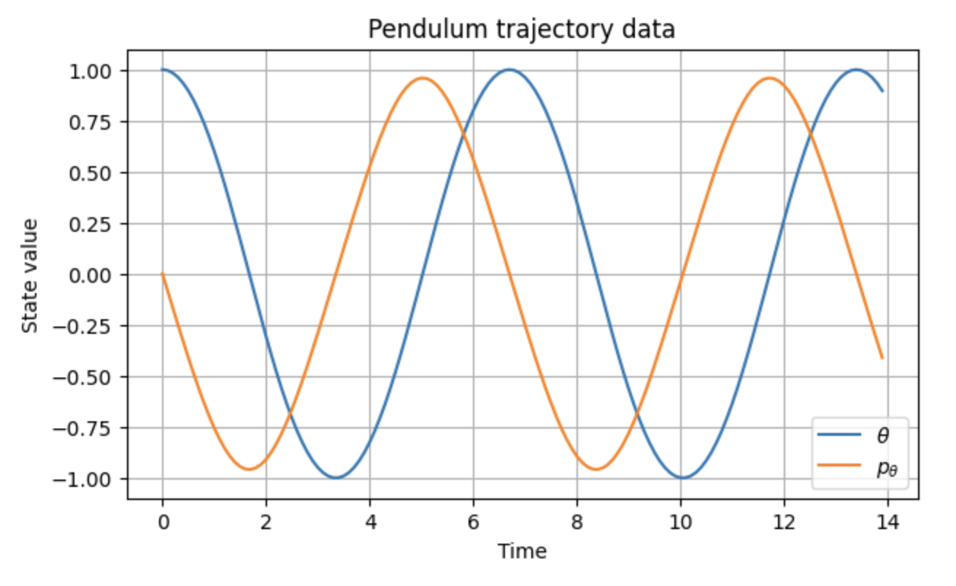
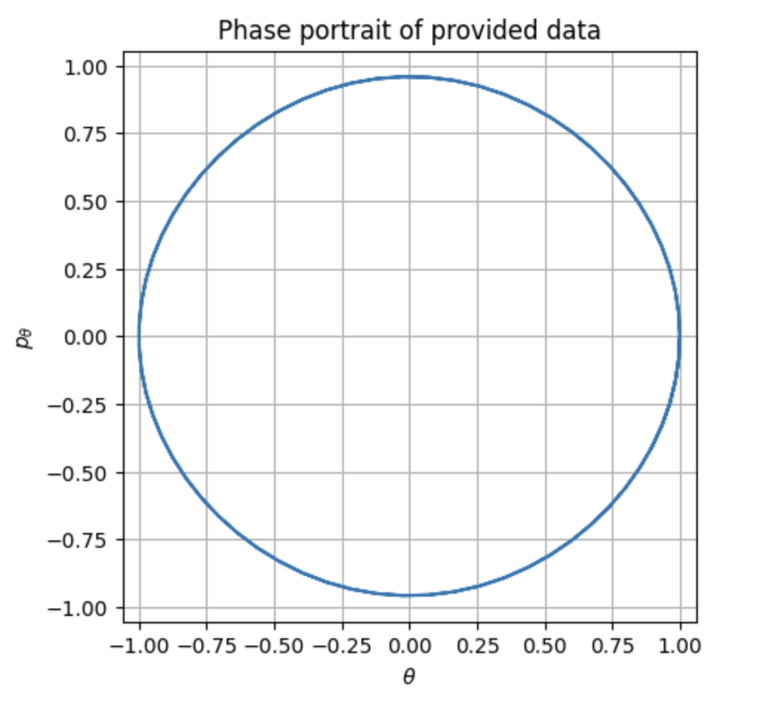
Background - Dataset
Non dimensionalized system with m = l = g = 1
140 total time steps: train.txt (n=40), test.txt (n=100). Initial conditions [pθ(0), θ(0)] = [0, 1].
Trajectory data generated using the symplectic Störmer–Verlet integrator (h = 0.1)
Chosen because it preserves Hamiltonian structure and long-time energy stability.

Slide 4
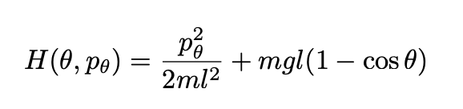
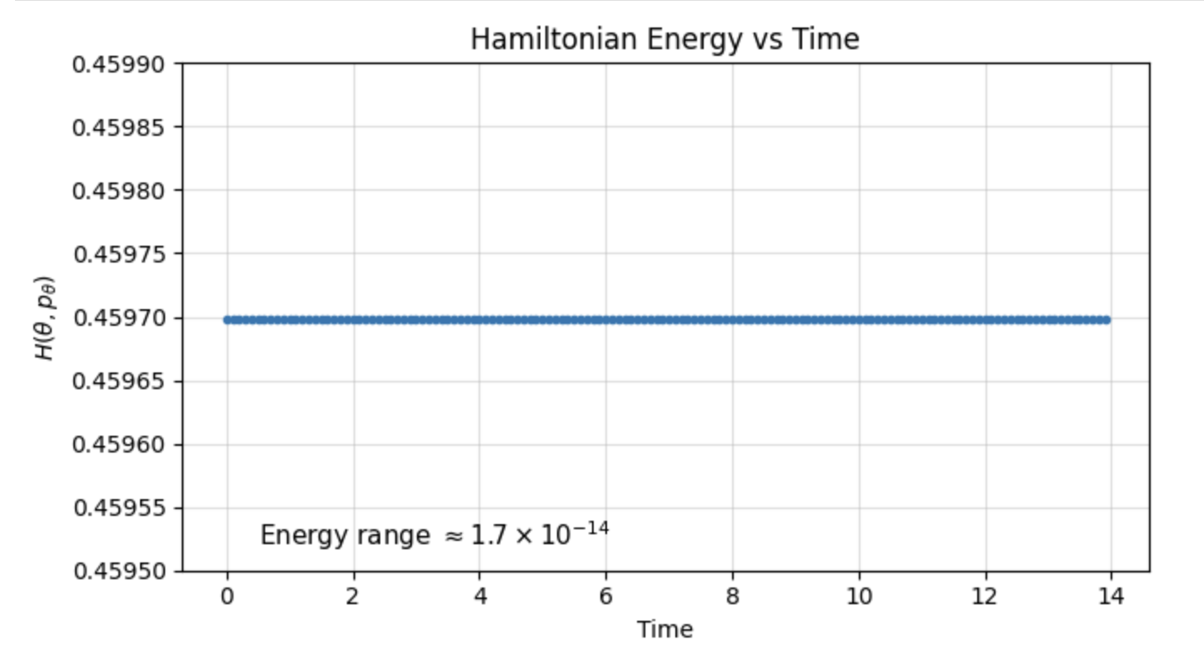
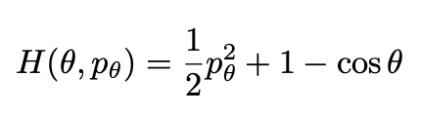
Physics Sanity Checks
Hamiltonian:
1st term: kinetic energy
2nd term: gravitational potential energy
m = l = g = 1:
For a frictionless pendulum, the total Hamiltonian energy should remain constant over time.

Slide 5
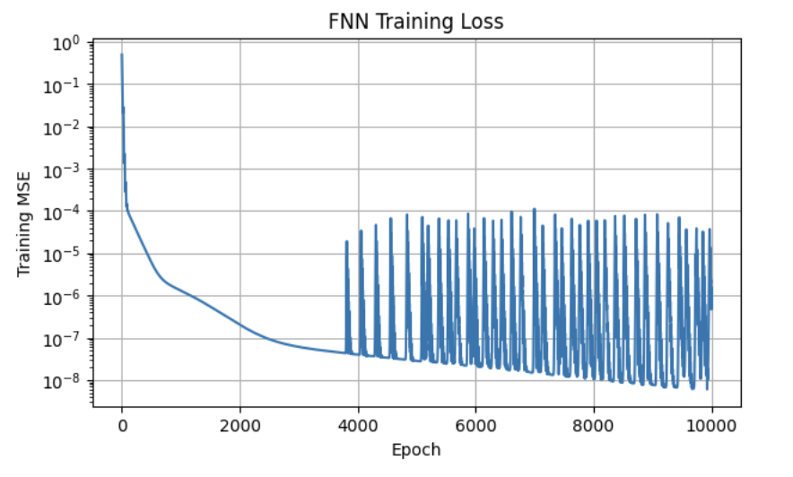
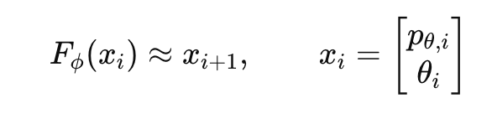
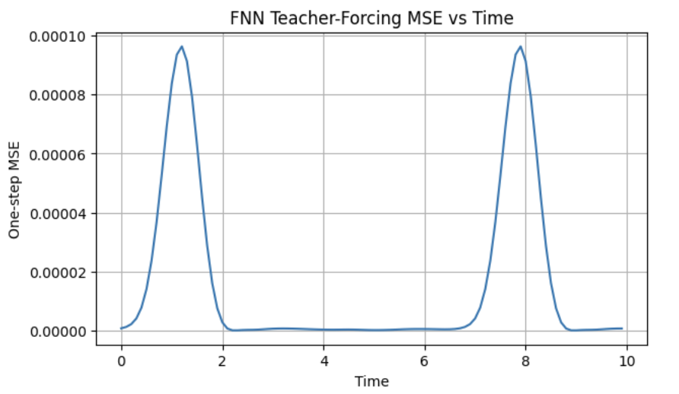
FNN
Feedforward neural network trained on one-step transitions
Loss: MSE
Optimizer: Adam, learning rate = 10⁻³
Mean teacher-forcing MSE: 1.66 × 10⁻⁵
FNN accurately learns local one-step dynamics.

Slide 6
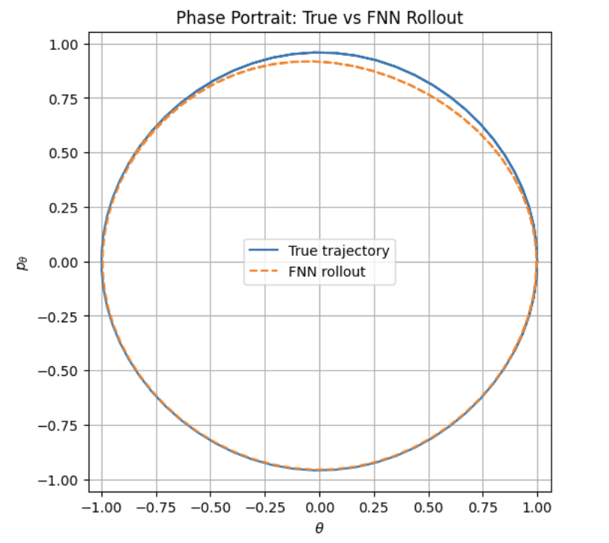
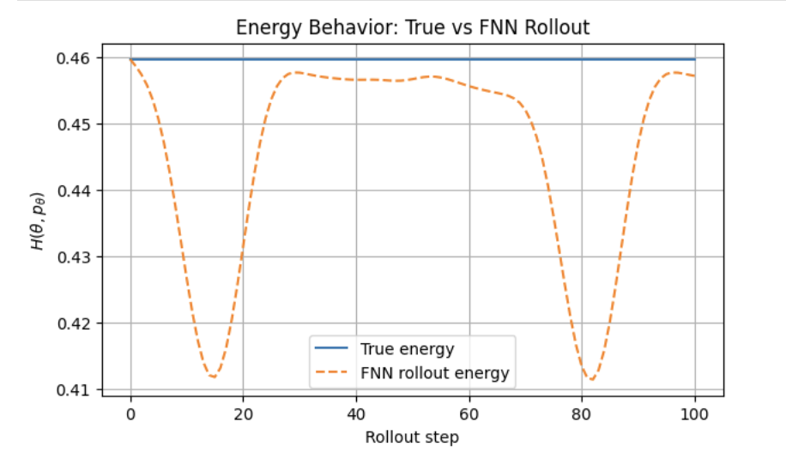
FNN
One-step errors accumulate during rollout
Rollout drifts away from the true Hamiltonian orbit
FNN does not explicitly preserve Hamiltonian structure
Energy variation: 4.82×10⁻² (vs 10⁻¹⁴ for true dynamics)

Slide 7
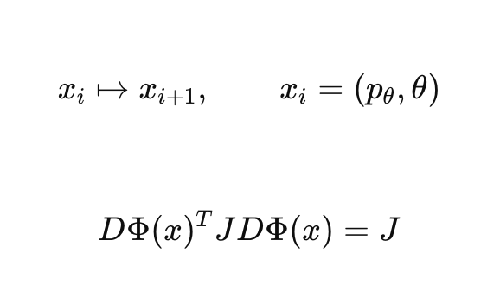
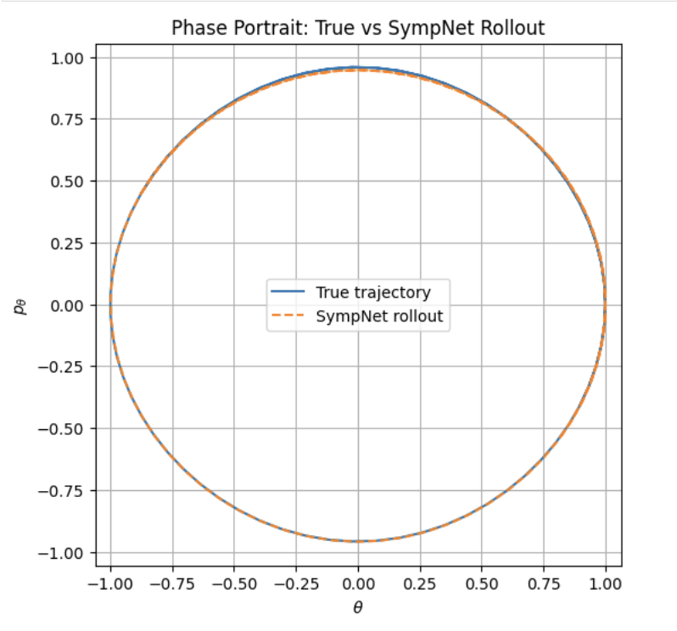
SympNet
• SympNet enforces symplectic structure in phase space
• Built from alternating symplectic shear maps
• Goal: improve long-term rollout stability

Slide 8
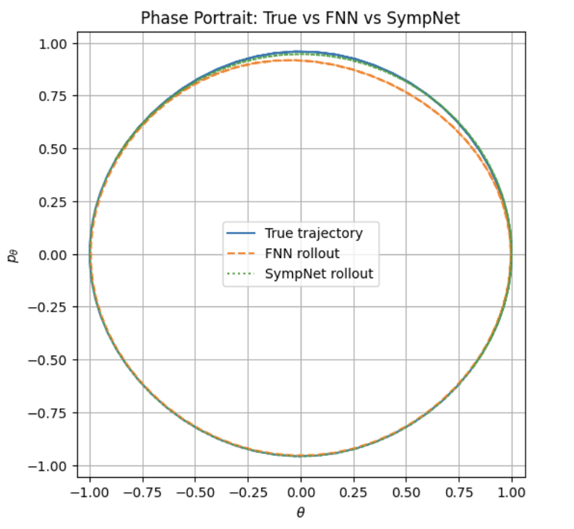
SympNet
• SympNet preserves orbit geometry better
• Energy drift reduced:
ΔH:
FNN ≈ 4.8×10⁻²
SympNet ≈ 1.5×10⁻²
• Rollout MSE remains larger than FNN
• Better physics consistency does not guarantee lower pointwise error
Structure preservation improves physical consistency,
but not necessarily rollout MSE.

Slide 9
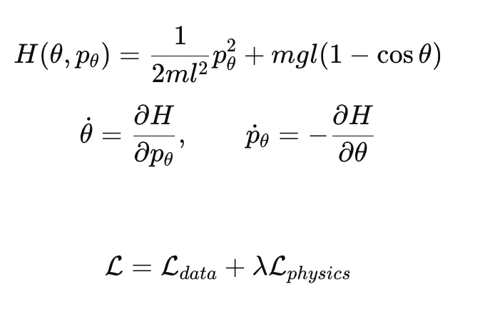
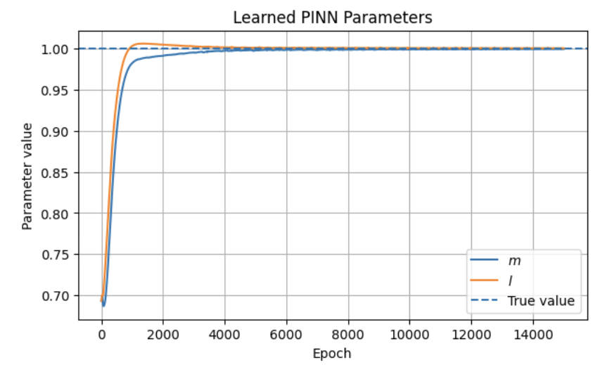
PINN
• PINN learns physical parameters m and l from trajectory data
• Loss combines data fitting + Hamiltonian physics residual
• Learned: m ≈ 0.9994, l ≈ 1.0003
• Parameters converge close to true values
Trajectory data are sufficient to recover the true pendulum parameters.

Slide 10
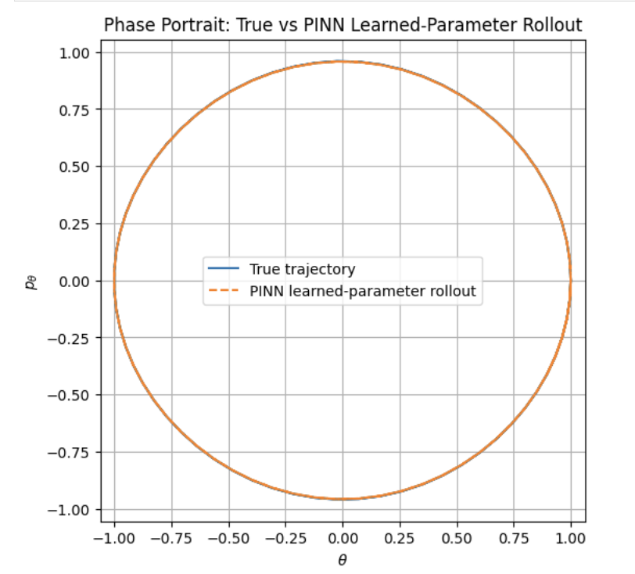
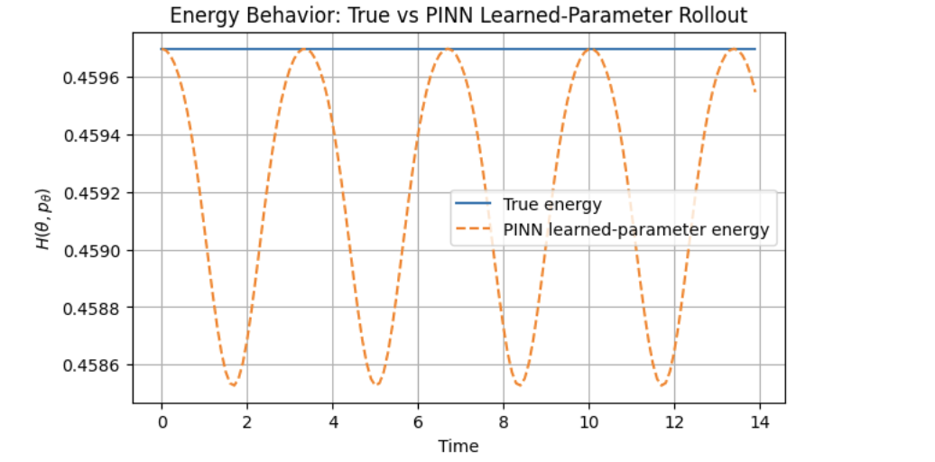
PINN
• PINN rollout closely matches the true orbit
• Mean rollout MSE: 1.45 × 10^-6
• Energy drift remains very small: ΔH ≈ 1.17 × 10^-3
PINN recovers both accurate trajectories and physically consistent dynamics.

Slide 11
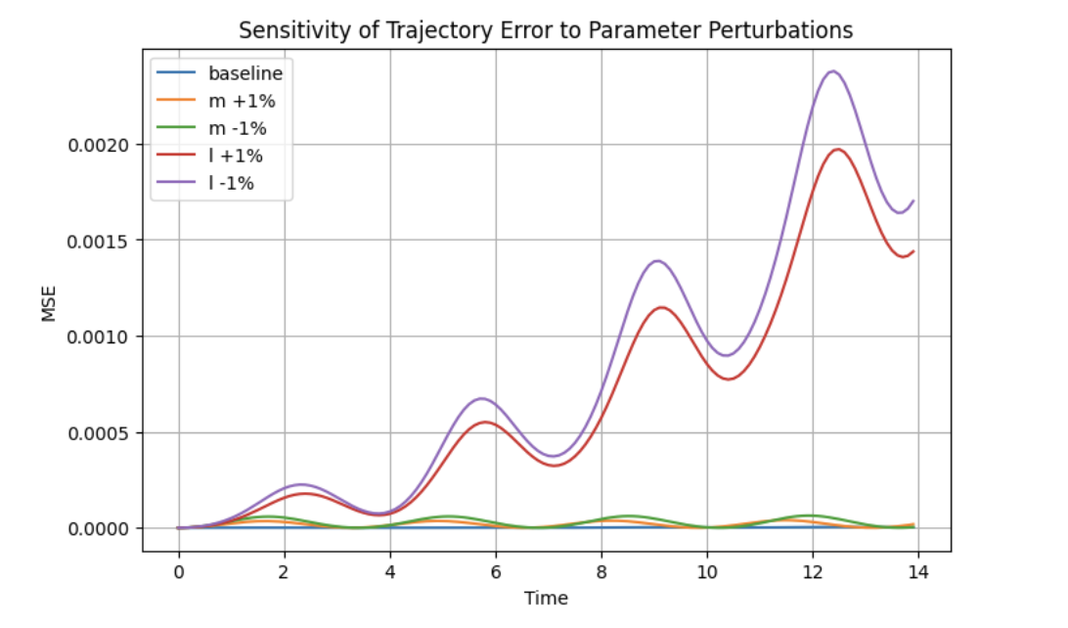
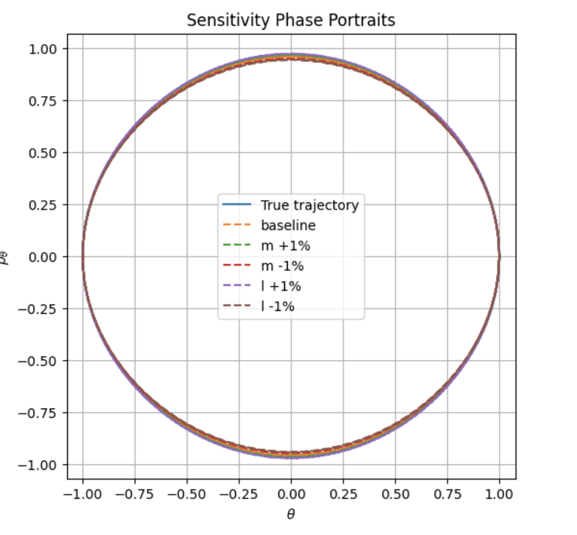
PINN
• ±1% parameter perturbations cause growing trajectory error
• Length perturbations affect rollout more strongly than mass perturbations
• Small parameter errors accumulate over long horizons
Small parameter uncertainty can produce large long-time trajectory deviations.

Slide 12
Comparative Analysis: FNN vs SympNet vs PINN
Property | FNN | SympNet | PINN
Inductive bias | Low | Medium | High
Physics structure | None | Symplectic geometry | Hamiltonian dynamics
Data efficiency | Lower | Medium | Higher
Long-time energy behavior | Weak | Good | Best
Rollout MSE (this experiment) | Best | Worse than FNN | Best overall
Robustness to distribution shift | Lower | Medium–High | Highest
Increasing physical inductive bias improves consistency and robustness, but stronger structure does not always minimize rollout error.

Slide 13

Thank you!

